Slide 1
WEST NILE VIRUS
Group 4
Darion, Joseph,
Rebecca, Riche

Slide 2
CONTENTS
Introduction
Problem Statement
Methodology
Exploratory Data Analysis
Feature Engineering
Feature Importance
Model Selection & Evaluation
Cost-Benefit Analysis
Conclusion & Recommendations

Slide 3
INTRODUCTION
Background: Due to the recent epidemic of West Nile Virus in Chicago, the Department of Public Health has set up a surveillance and control system to collect data on mosquito population over time

Slide 4
PROBLEM STATEMENT
Using the mosquito data collected over time, derive an effective plan to deploy pesticides throughout the city to control the mosquito population
Approach: Using ML/NN with Binary Classification, discover the important features for predicting the presence of WNV and develop a model to make predictions that the city of Chicago can use when it decides where to spray pesticides

Slide 5
WHAT IS WEST NILE VIRUS?
Effects
02
Transmission
01
Incurable
03
While most people infected with WNV do not feel sick, about 1 in 5 people develop a fever and flu-like symptoms. Age group over 60 is the most vulnerable.
WNV is transmitted to humans via the bite of infected mosquitoes.
Currently, there are no medication for the virus, prevention is the only way to stop the virus.

Slide 6
1,000
60
Cases detected in US 2019
Deaths caused
Notes:
https://www.cdc.gov/westnile/resources/pdfs/data/WNV-Disease-Cases-PVDs-by-State-2019-P.pdf

Slide 7
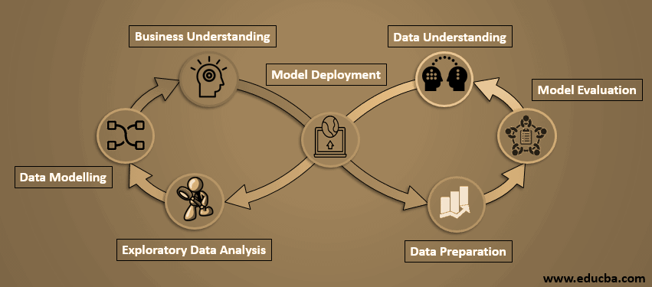
METHODOLOGY

Slide 8
WHAT IS IN THE DATA?
Data used for the prediction model is from a Kaggle competition for West Nile Virus Prediction for the city of Chicago (link)
Data provided:
Main dataset contains testing results of mosquitos found in traps placed in Chicago. WNV test data has been split into a train and a test dataset.
Spray dataset contains the spray dates and locations of the spray.
Weather dataset contains the weather conditions of each day at the two weather stations.
Notes:
In this project, we will look into three different datasets; Train, Weather and Spray.
The Train dataset contains the data for the number of mosquitoes caught at specific traps. It contains the date, species of the mosquitoes, the trap address and if WNV was found in the mosquitos.
The Spray dataset contains the data for spray dates and location of the sprays
The weather dataset contains the weather condition for each day at the two weather stations

Slide 9
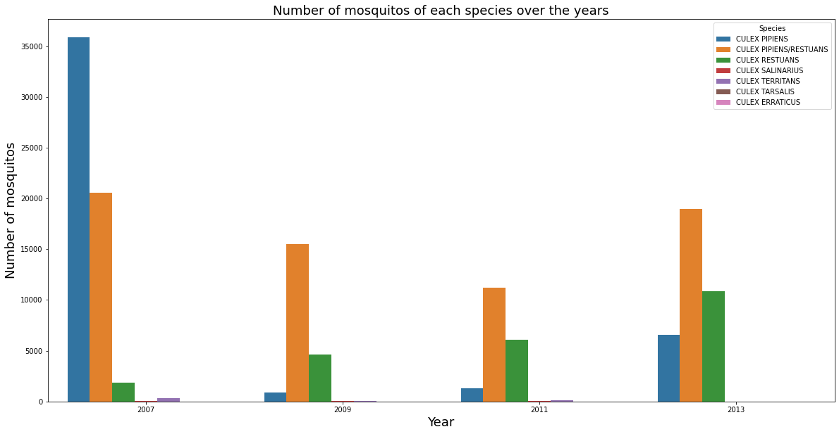
EDA: TRAIN DATA
Total number of mosquitoes dropped over the years, especially the Culex Pipiens species. It experienced a tremendous drop from 2007 to 2009.
Observed only two species that carry the Wnv virus, namely the Culex Pipiens and Culex Restuans.
WNV Mosquitoes Species
CULEX PIPIENS/RESTUANS | 262
CULEX PIPIENS | 240
CULEX RESTUANS | 49
Notes:
They are only two types of species which carry the virus.
The chart above shows the number of mosquitoes classified based on the type of species.

Slide 10
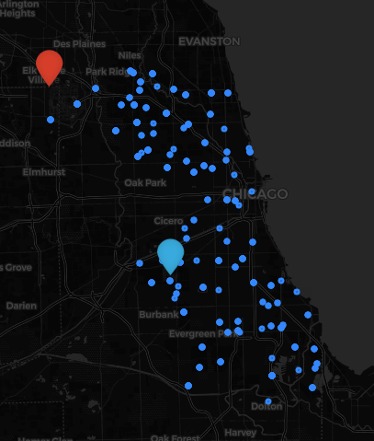
EDA: WEATHER STATIONS & TRAPS
The map (on the right) shows the location of the traps and weather stations.
Appended the weather data to the traps data.
Based on the traps’ proximity to the weather station.
WS1 Data
WS1
WS2 Data
WS2
Traps - Blue Dots
Notes:
The map beside shows the location of the traps and weather stations.
The blue dots indicate the traps’ locations. The red marker is Weather Station One and the blue marker is Weather Station Two.
As the weather data we used are from these two weather stations, we have grouped the traps based on the distance between the station and itself.

Slide 11
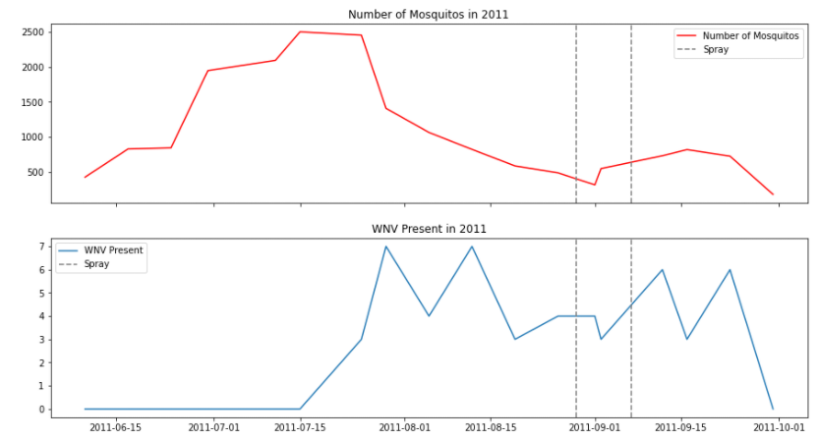
EDA: MOSQUITOES NUMBERS & WNV IN 2011
Two sprays were done in 2011, with little observable effect on the mosquito population and WNV presence
Notes:
JOSEPH

Slide 12
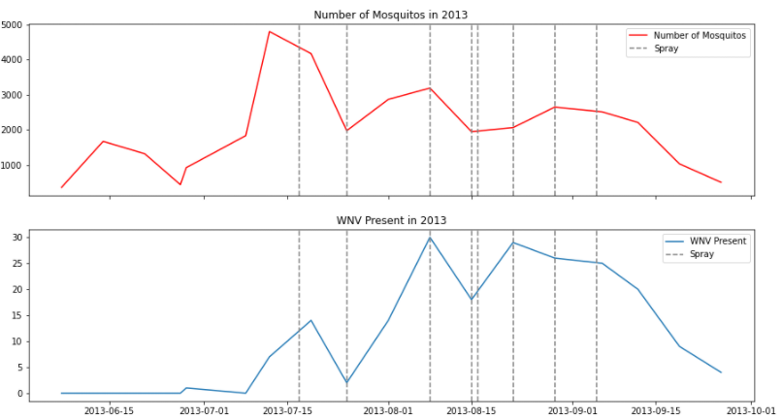
EDA: MOSQUITOES NUMBERS & WNV IN 2013
1st spray in 2013 had helped to reduce the number of mosquitos and WNV presence
2nd spray did not have the same effect, perhaps location of spray was not ideal
Notes:
JOSEPH

Slide 13
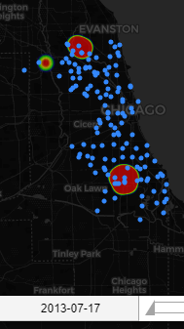
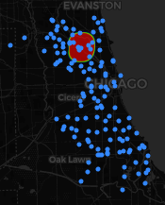
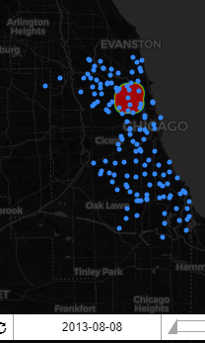
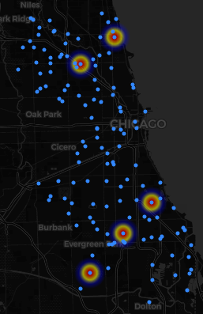
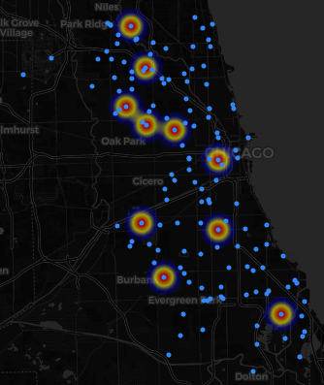
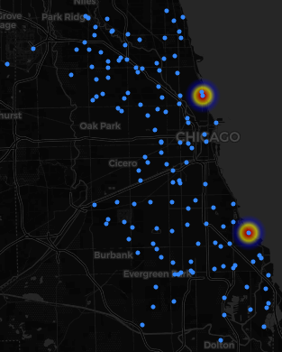
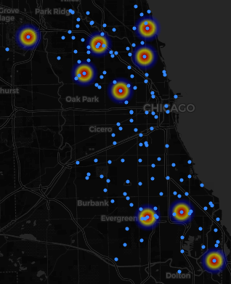
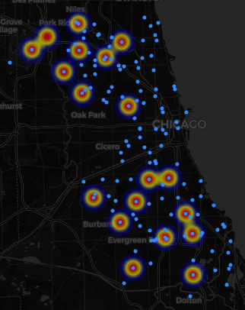
EDA: SPRAY & SPREAD OF WNV
Spray Timeline
2013-07-17
2013-07-25
2013-08-08
2013-07-12
2013-07-19
2013-07-25
2013-08-01
2013-08-08
Mosquito Spread Timeline
Notes:
JOSEPH
Next, we will look at the effect of the spray on the Wnv Mosquitoes.
We will be tallying the locations of the spray and locations of the mosquitoes presence at the next two slides.
We will be using the dates in year 2013.
Spray: 07-17,07-25,08-08, 08-15,08-22,08-29,09-05
Mosquitoes: 07-12, 07-19, 07-25, 08-01 , 08-08, 08-15, 08-22, 08-29, 09-06, 09-12

Slide 14
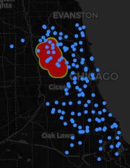
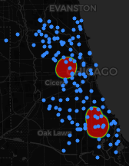
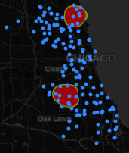
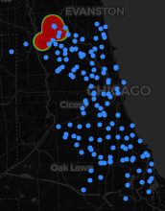
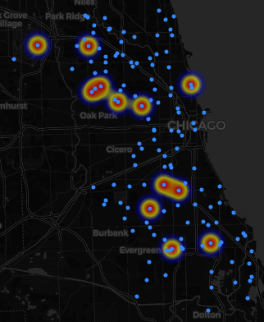
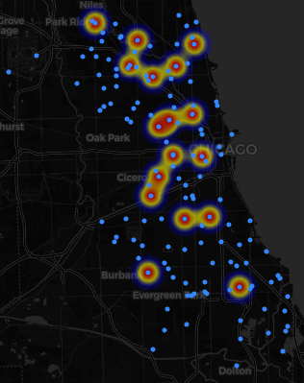
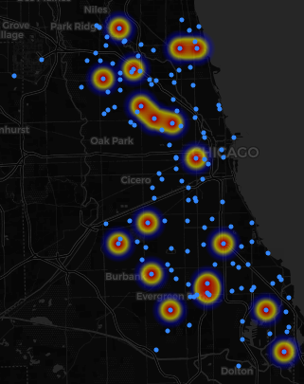
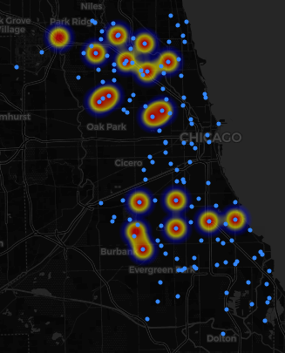
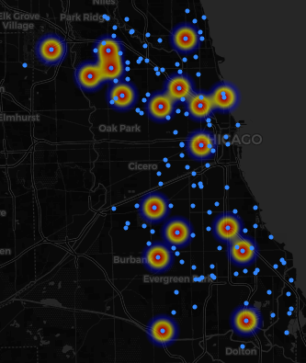
EDA: SPRAY & SPREAD OF WNV
Spray Timeline
2013-08-15
2013-08-22
2013-08-29
2013-09-05
2013-08-15
2013-08-22
2013-08-29
2013-09-06
2013-09-12
Mosquito Spread Timeline
Notes:
JOSEPH
From the spray dataset, we included a feature trap_sprayed to indicate if the trap was within the spray’s effective range, 30 days from the spray date.

Slide 15
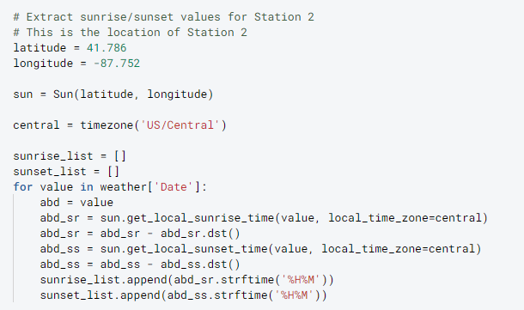
EDA: SUNSET & SUNRISE
This dataset contains the weather conditions data for Station 1 and 2. However, there are some missing data for some of the features.
Two of the features affected are Sunset and Sunrise timings. The missing data were from Station Two.
Using the Sun, Timezone, Latitude and Longitude, we managed to fill in the missing data for Station Two.
Another feature affected is Temperature Average. For that, we took the Max and Min Temperature’s Mean to fill in the missing data.
Above code is for getting the Sunset and Sunrise timing for Station Two.

Slide 16
FEATURE ENGINEERING: WEATHER
01
03
Humidity Feature
Time-Lag Features
Sun Hours
Code Sums
02
04
As the mosquitoes’ breeding cycle might vary from 1 to 8 weeks, time-lagged weather features were created
High Humidity conditions favor mosquito activity, while low humidity suppresses activity and may even cause mortality
This feature contains the different weather conditions code. As not all weather conditions are present, we grouped the remaining conditions to ‘Dry’ or ‘Wet’
Mosquitos are most active from dusk to dawn. The number of hours with sunlight might help in the modelling

Slide 17
WEATHER FEATURES
Time-Lag Features
As mosquitoes require one to eight weeks duration to be incubated and grow, we created 4 weekly time-lag average variable for each of the weather features.
Weather Condition Features
Average Temperature
Wet Bulb Temperature
Precipitation
Station Pressure
Sea Level
Resultant Wind Speed
Resultant Wind Direction
Average Wind Speed
Engineered Weather Features
Sun Hours
Wet/Dry Day
Humidity
Notes:
To summarize, these are the weather features after feature engineering

Slide 18
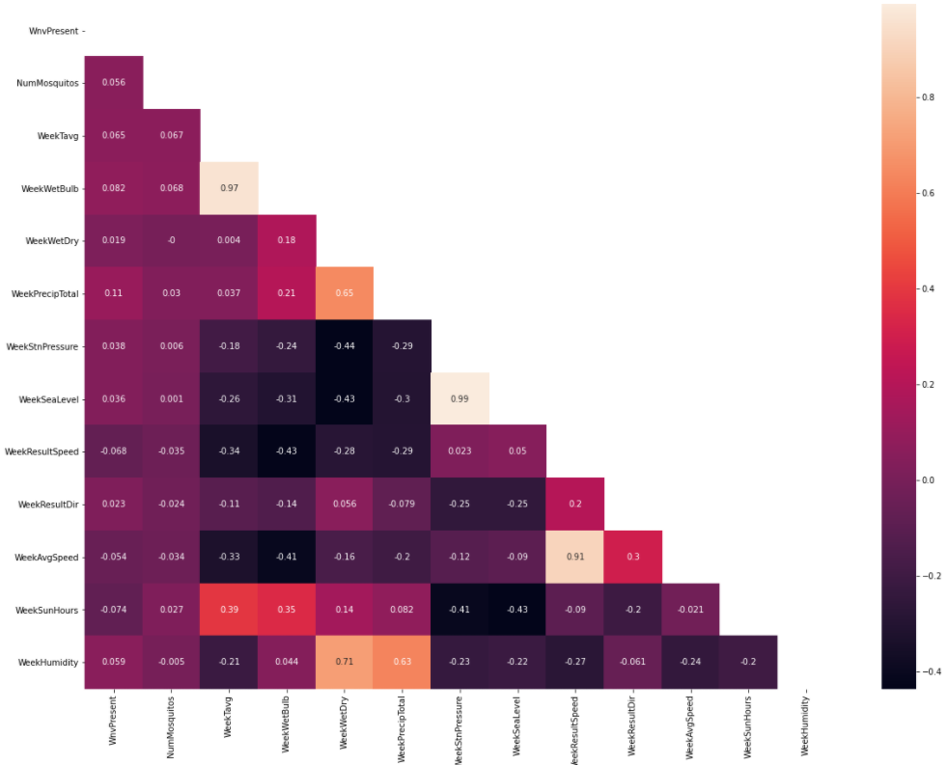
EDA: WNV MOSQUITOES & WEATHER CONDITIONS
Weather Conditions
As we study the different weather conditions, we will look specifically on five weather conditions which will affect the growth of mosquitoes.
The five conditions are:
Wind
Temperature
Precipitation
Humidity
Sunlight Duration
Notes:
Five weather conditions which affect mosquitoes growth:
Wind - Wind affect the flight of mosquitoes, preventing them to fly around easily
Temperature - Mosquitoes are only able to grow at able 50 degrees Fahrenheit
Precipitation - High precipitation causing rain will create puddle of waters, which are breeding spots for mosquitoes. However, rain can affect mosquitoes flight, stopping them to flying around.
Humidity - High humidity favors mosquito activity
Sunlight - Mosquitoes will usually lay and breeds in the night as they are unable to thrive in the sun.

Slide 19
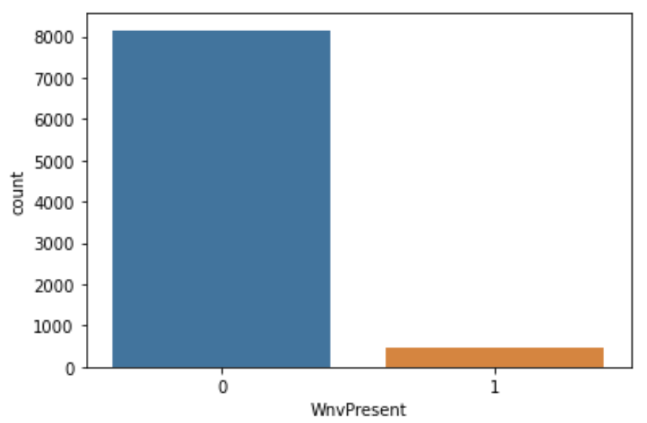
PREPROCESSING
~95% of data
Heavily imbalanced data in training set.
Baseline prediction: 95% Wnv Not Present.
Optimize AUC score instead of accuracy.
Adopt over-sampling technique such as SMOTE.
Synthetic
Data
Notes:
Of course, we also scaled our data.

Slide 20
MODELLING
Logistic Regression
Adaptive Boost
Naive Bayes
ExtraTrees
Random Forest
Gradient Boosting
Support Vector
Neural Network

Slide 21
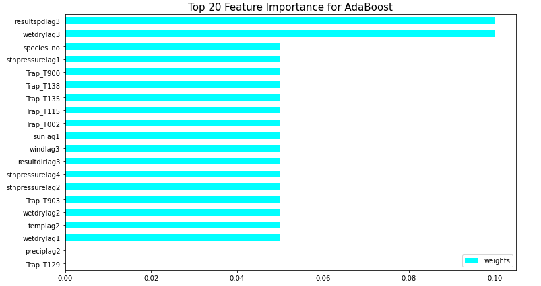
FEATURE IMPORTANCE: ADABOOST

Slide 22
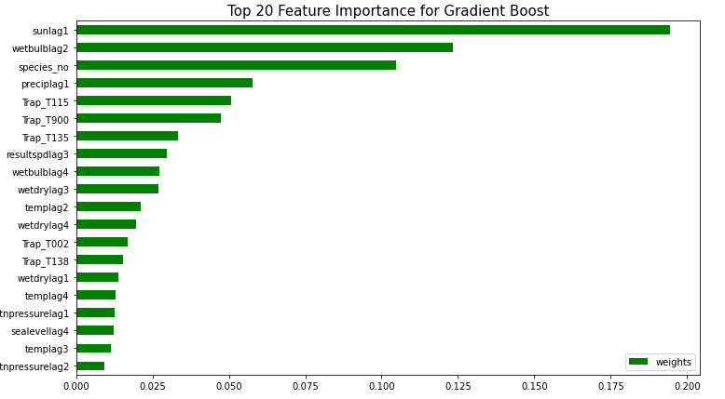
FEATURE IMPORTANCE: GRADIENT BOOSTING

Slide 23
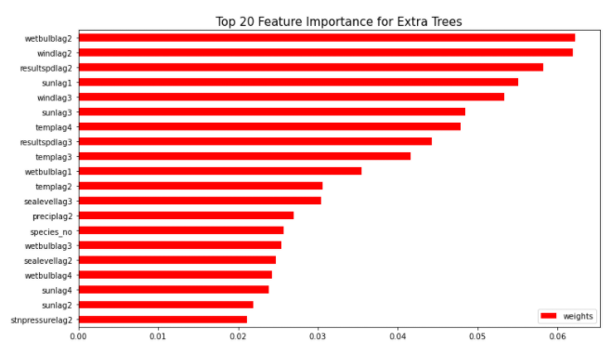
FEATURE IMPORTANCE: EXTRA TREES

Slide 24
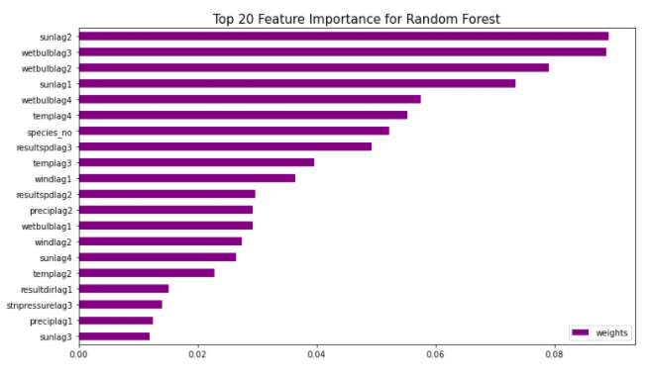
FEATURE IMPORTANCE: RANDOM FOREST

Slide 25
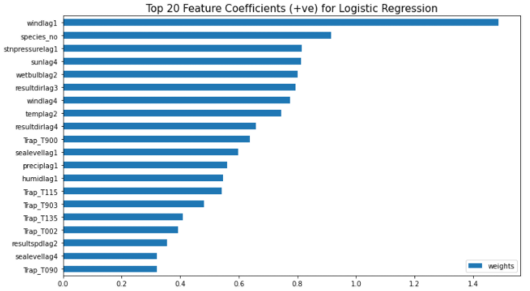
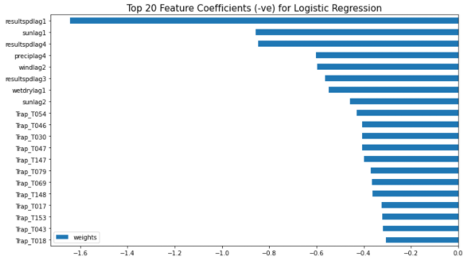
FEATURE IMPORTANCE: LOGISTIC REGRESSION
Top features
Best params:
solver='newton-cg'
C=0.1
Notes:
Top 20 Positive Coefficients & Top 20 Negative Coefficients

Slide 26
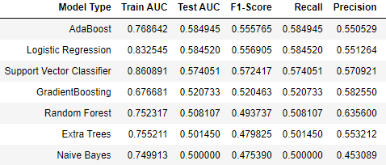
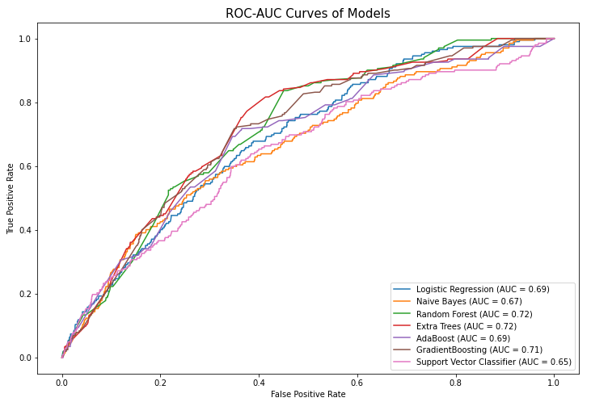
MODEL SELECTION
AdaBoost Model
Highest Test AUC score.
Highest Recall score.
Lowest number of False Negatives.
Some overfitting, but acceptable.
 | Predicted Negative | Predicted Positive
Actual Negative | 0.76 | 0.14
Actual Positive | 0.06 | 0.03
Normalized Confusion Matrix – Positive = Wnv Present
Notes:
Because the target variable is heavily imbalanced, we could not reliably judge a model's performance based on accuracy and decided to optimize the models on ROC-AUC instead. ROC is a probability curve and AUC represents degree of measure of separability. It is a good measurement of how much the models are capable of distinguishing between the classes 0 and 1. The higher the AUC, the better the model is at predicting the class correctly. Putting into context, the higher the AUC, the better the model is at distinguishing between mosquito traps with Wnv present and Wnv NOT present.
Highest Test AUC score. It is very close to 1, indicating that it is a good model at predicting the classes correctly.
Highest recall score, which represents the fraction of retrieved relevant instances among all relevant instances. In other words, it measures the proportion of positives that are correctly identified (i.e. the proportion of data entries predicted at Wnv present and are truly Wnv present).
Lowest number of False Negatives (i.e. predicting that Wnv is not present when it is actually present), which is the most important due to some reason. In our opinion, it is unethical to tell the public that a certain location do not have presence of Wnv when there is actually Wnv present. As such, having a very small number of False Negatives is very important.
Although there is a difference between the train and test scores which suggests overfitting, it is still acceptable by our means, also taking into account that this is common for AdaBoost model.
Therefore, we will select AdaBoost as the production model for predict the presence of the West Nile Virus.

Slide 27
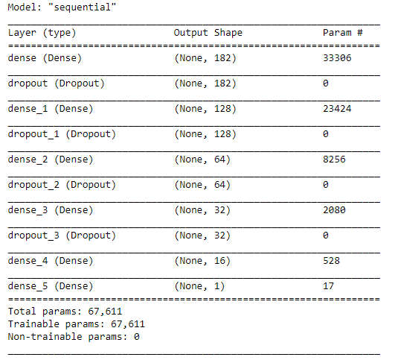
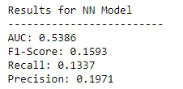
ADDITIONAL MODEL: NEURAL NETWORK
Lower Test AUC score compared to AdaBoost.
Low complexity neural network.
Not easily interpretable.
Neural Network Summary
Notes:
For exploration, we also developed a neural network with 4 hidden layers.
After predicting the results using the neural network, we observed that the scoring metrics are actually not as high as our production model. This could be due to the small number of neural network layers and its low complexity. If given a much longer timeframe, it is definitely possible to build a neural network with a very high AUC score. However, in this project we will stick with our production model since it could be interpreted more easily as compared to a neural network.

Slide 28
COST-BENEFIT ANALYSIS
 | City Level Spraying | Targeted Spraying
Direct Cost ($0.92/acre) Spray(truck/backpack) | $1,653,467.04 | $175,086.72
Indirect Cost: Hospitalization cost Loss of production cost | - | $459,617.3 (using yr 2020 as a benchmark due to falsely predicted negative)
Benefits | $634,704.05 (If the control of mosquito is done regularly on a city level spraying, the chances of a west nile virus case is effectively 0. The amount saved from both the indirect and direct costs associated if we were to use the targeted spray can be used to fund the city level spraying) | $1,018,762.99 (amount saved from excessive spraying which could be used to increase catch basins and maintenance of them, leading to increase in data for better analysis to increase accuracy and decrease west nile virus cases efficiently)
Benefit-cost ratio | 0.38 | 1.61
Notes:
REBECCA

Slide 29

CONCLUSIONS & RECOMMENDATIONS
Do
Important features:
Mosquito species - some species are more competent vectors of Wnv
Duration of the day - longer the Sun is out, the lower the mosquito activity
Temperature - lower the temperature, lower the mosquito activity
Wind - higher the wind speed, lower the mosquito activity
Humidity - lower the humidity, lower the mosquito activity
Use insect repellent that contains DEET, Picaridin, IR3535 or Oil of Lemon Eucalyptus
Eliminate stagnant water
Wear long pants, long-sleeved shirts at night
Notes:
we found that the species type, the duration of the Sun, temperature, wind, humidity are consistently strong predictors across the models. Based on research, mosquitoes are active between dusk and dawn, when the air is calm. This is synonymous with the interpretations which we did on the various models, where the presence of Wnv is more prevalent when the sun has set. Another important factor to the presence of Wnv is the mosquito species, where we observed that culex pipiens and culex restuans mosquitoes are strong vectors of spreading the Wnv. Other studies further substantiated these observations, affirming that these mosquito species are the main vectors for the Wnv and there is similar vector competence between the two [source 1][source 2]. In addition, research showed that mosquitoes flourish in moist, relatively warm environments and a less windy environment enables mosquitoes to navigate easily to feed on humans.
Everyone has a part to play! Residents are encouraged to take the following measures for prevention against mosquitoes:
Use insect repellent that contains DEET, Picaridin, IR3535 or Oil of Lemon Eucalyptus
Eliminate stagnant water.
Keep grass and weeds short to remove hiding places for adult mosquitoes
Wear loose-fitting, light colored clothing, long pants, long-sleeved shirts, socks and shoes between dusk and dawn
Ensure all screens,windows and doors are tight fitting with no holes

Slide 30
MOVING FORWARD
Demographics
01
Geography
02
Mosquito Species
03
Human demographics within the area affects probability of Wnv.
Landscapes affect the mosquitoes’ livelihoods and activity.
Study other species that could possibly spread the virus.
Notes:
Human demographics: It could be easily hypothesized that higher human population and density would increase the probability of a Wnv case.
Geographic Information: More geographic information could also be useful in studying the presence of Wnv. Since Wnv is spread through moquitoes, we could expect that proportion of open water sources, percentage of grass land, forests, and urban landscape are all factors of the livelihood of these mosquitoes.
Mosquito Species: The data which we studied only included the culex moquito species, because it is more prominent in the city of Chicago. If we were to expand our studies to the rest of the United States, data on more mosquito species could be useful, such as the Culex Tarsalis and Culex Quinquefasciatus. These species are found to be the main vector species in the United States. Although Culex mosquitoes are accepted as the primary global transmission vector, it is possible for other mosquito species to acquire and transmit Wnv. There are reports of Wnv in Aedes mosquitoes as well and data on more mosquitoes species could paint us a more complete picture.

Slide 31
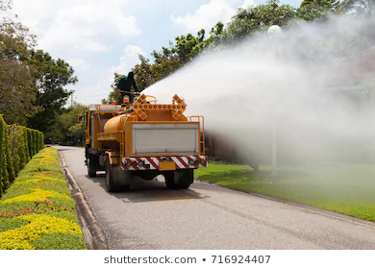
THANKS
Do you have any questions?

Slide 32
Sources
Prevention Measures - [https://www.chicago.gov/city/en/depts/cdph/provdrs/health_protection_and_response/news/2020/july/cdph-conducts-a-comprehensive-mosquito-surveillance-and-control.html]
Life Cycle of Mosquitoes - [https://www.mosquito.org/page/lifecycle]
Mosquito Treatment Duration - [https://www.callnorthwest.com/2019/05/how-long-does-a-mosquito-treatment-last/]
Mosquito Spray Information - [https://www.montcopa.org/DocumentCenter/View/8932/FAQMosquitoSpraying?bidId=]
Calculation for Sunrise/Sunset for Station two - [https://stackoverflow.com/questions/38986527/sunrise-and-sunset-time-in-python/38986561)]
Daylight Savings For Calculations - [(https://www.timeanddate.com/time/zone/usa/chicago)]

